Slide 1

Innovative Stroke Care:
The Power of Data and Machine Learning
Submitted by : RUBAKUMARAN R

Slide 2
ABSTARCT
Strokes have rapidly raised globally even at not only in older ages but also in juvenile ages. Stroke can be controlled by its earlier prediction and taking the best treatment. For our work, we collected the dataset of various patients from Kaggle which contains various medical factors. We used Jupyter notebook to work on this dataset. Machine learning algorithms are used to predict whether the person is suffering from a stroke or not. We preprocessed the data by identifying and handling the missing values. One Hot encoder to convert the categorical values into numerical values. The Feature Scaling step is used to normalize the range of independent variables.

Slide 3
CHAPTER | PARTICULARS | PAGE NO:
Chapter 1 | Introductions: Scenario & Goals, Features & Predictor | 04
Chapter 2 | Features & Predictor | 08
Chapter 3 | Methodology: Data Cleaning Preprocessing Machine Learning Algorithms Implementation Steps | 10
Chapter 4 | Analysis of the Result | 37
Chapter 5 | Conclusions | 39
 | Reference | 40

Slide 4
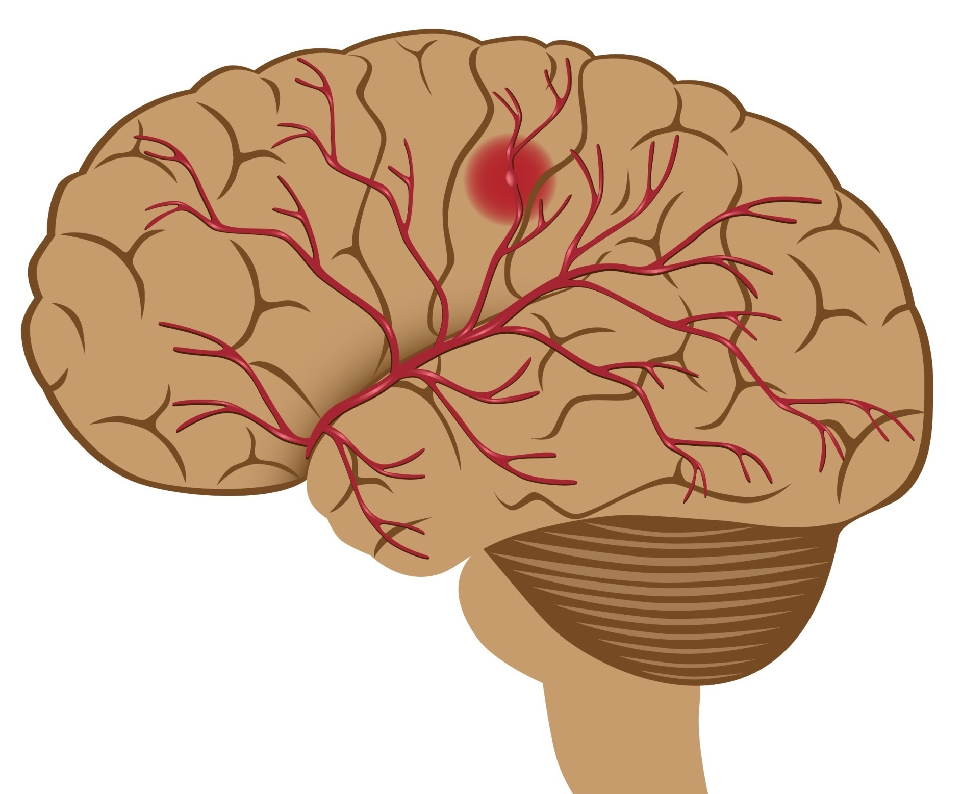
Chapter - 1 Introduction

Slide 5
Nowadays, stroke is a major health-related challenge. Stroke, also known as cerebrovascular accident, consists of a neurological disease that can result from ischemia or hemorrhage of the brain arteries, and usually leads to heterogeneous motor and cognitive impairments that compromise functionality.
Annually, stroke affects about 16 million individuals worldwide and is associated with enormous societal costs.
WHO identifies ischaemic heart disease and stroke as the two leading causes of mortality and disability worldwide.
According to the American Heart Association, stroke is considered a severe health issue due to its high mortality rate
Also the cost of hospitalization for stroke is increasing and consequently, there is an increased need of advanced technologies that can assist in clinical diagnosis, treatment, predictions of clinical events, recommendation of promising therapeutic interventions, rehabilitation programs, etc.
Early detection of stroke is a crucial step for efficient treatment and ML can be of great value in this process. To be able to do that, ML is an ultimate technology which can help health professionals make clinical decisions and predictions. . It has become a captivated research problem as there are various parameters that can effect the outcome.
The causes consist of work type, glucose level, body mass index, gender, residence type, age, average smoking status of the individual and any previous heart disease. The proposed models foresee stroke prediction of several individuals using various machine learning algorithms like Decision Tree , K-Nearest Neighbors, Naive Bayes, Support Vector Machine, and etc.

Slide 6
What is Brain Stroke ?
Brain Stroke happens when there is a blockage in the blood circulation in the brain or when a blood vessel in the brain breaks and leaks. The burst or blockage prevents blood and oxygen reaching the brain tissue. Without oxygen the tissues and cells in the brain are damaged and die in no time leading to many symptoms. Once brain cells die, they generally do not regenerate and devastating damage may occur, sometimes resulting in physical, cognitive and mental disabilities. It is crucial that proper blood flow and oxygen be restored to the brain as soon as possible.
What is the problem we are trying to solve ?
Determine whether or not a patient will have a stroke in the next year automatically using his/her historical medical information.
Scenario :
You have just been hired as a Data Scientist at a Hospital with an alarming number of patients coming in reporting various stroke symptoms. A stroke measures vitals & hands you this data to perform Data Analysis and predict whether certain patients have Brain Stroke. We would like to make a Machine Learning algorithm where we can train our AI to learn & improve from experience. Thus, we would want to classify patients as either positive or negative for Brain Stroke.

Slide 7
Goal :
Predict whether a patient should be diagnosed with Brain Stroke.
This is a binary outcome. Positive (+) = 1, patient diagnosed with Brain Stroke. Negative (-) = 0, patient not diagnosed with Brain Stroke.
Experiment with various Classification Models & see which yields greatest accuracy.
Examine trends & correlations within our data.
Determine which features are most important to Positive/Negative Brain Stroke diagnosis.

Slide 8
Chapter - 2 Features & Predictor
Our Predictor (Y, Positive or Negative diagnosis of Brain Stroke) is determined by 10 features (X):
Gender: "Male", "Female“.
Age : Age of the patient.
Hypertension : 0 if the patient doesn't have hypertension, 1 if the patient has hypertension.
Heart _ disease : 0 if the patient doesn't have any heart diseases, 1 if the patient has a heart disease.
Ever _ married : "No" or "Yes“.
Work _ type : "Children", "Govt _ job", "Never _ worked", "Private" or "Self-employed“.
Residence _ type : "Rural" or "Urban“.
Avg _ glucose _ level : Average glucose level in blood.
Bmi : Body Mass Index.
Smoking _ status : "Formerly smoked", "Never smoked", "Smokes" or "Unknown“.
Stroke : "Yes" if the patient had a stroke or "No" if the patient not had a stroke.

Slide 9
Note :
"Unknown" in smoking _ status means that the information is unavailable for this patient.
Our data has 3 types of data:
Continuous: Which is quantitative data that can be measured.
Ordinal Data: Categorical data that has a order to it (0,1,2,3,etc).
Binary Data: Data whose unit can take on only two possible states(0&1).

Slide 10
Chapter – 3 Methodology
Data Cleaning and Pre-processing :
Before building a model, data pre processing is required to remove unwanted noise and outliers from the dataset that could lead the model to depart from its intended training. This stage addresses everything that prevents the model from functioning more efficiently. Following the collection of the relevant dataset, the data must be cleaned and prepared for model development. As stated before, the dataset used has eleven characteristics. The dataset is then inspected for null values and filled if any are detected. The null values in the column BMI are filled using the data column’s mean in this case. Label encoding converts the dataset’s string literals to integer values that the computer can comprehend. As the computer is frequently trained on numbers, the strings must be converted to integers. The gathered dataset has six columns of the data type string. All strings are encoded during label encoding, and the whole dataset is transformed into a collection of numbers. The dataset used for stroke prediction is very imbalanced. The dataset has a total of 5109 rows, with 249 rows indicating the possibility of a stroke and 4860 rows confirming the lack of a stroke. If such an unbalanced data is not dealt with properly, the findings will be inaccurate, and the forecast will be ineffective. As a result, to obtain an efficient model, this unbalanced data must be dealt with first.

Slide 11
Supervised Data
classification
regression
Classification gives out discrete values.
Given a group of data, this method helps group the data into different groups.
In classification, the nature of the predicted data is unordered.
In classification, the nature of the predicted data is unordered.
Classification is done by measuring the accuracy.
Regression gives continuous values.
It uses the mapping function to map values to continuous output.
Regression has ordered predicted data.
It attempts to find a best fit line. It tries to extrapolate the graph to find/predict the values.
Regression is done using the root mean square error method.

Slide 12
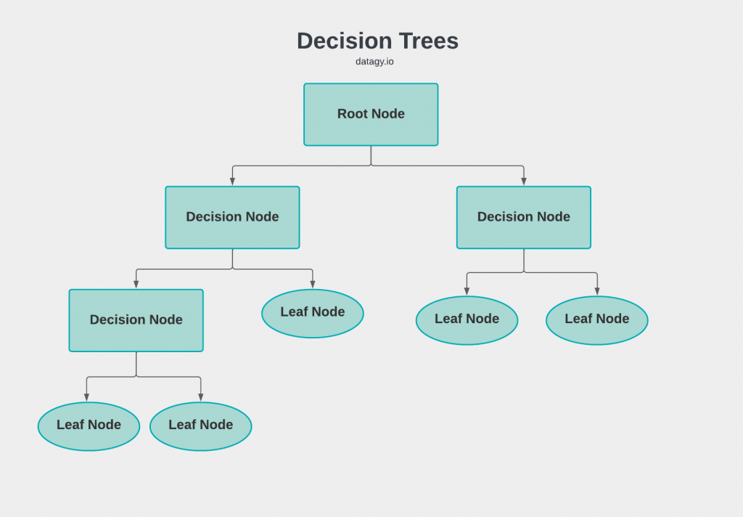
Machine Learning Algorithms:
Decision Tree :
Decision Tree is a Supervised learning technique that can be used for both classification and Regression problems, but mostly it is preferred for solving Classification problems. It is a tree-structured classifier, where internal nodes represent the features of a dataset, branches represent the decision rules and each leaf node represents the outcome. In a Decision tree, there are two nodes, which are the Decision Node and Leaf Node. Decision nodes are used to make any decision and have multiple branches, whereas Leaf nodes are the output of those decisions and do not contain any further branches. The decisions or the test are performed on the basis of features of the given dataset. It is a graphical representation for getting all the possible solutions to a problem/decision based on given conditions. It is called a decision tree because, similar to a tree, it starts with the root node, which expands on further branches and constructs a tree-like structure. In order to build a tree, we use the CART algorithm, which stands for Classification and Regression Tree algorithm. A decision tree simply asks a question, and based on the answer (Yes/No), it further split the tree into subtrees.

Slide 13
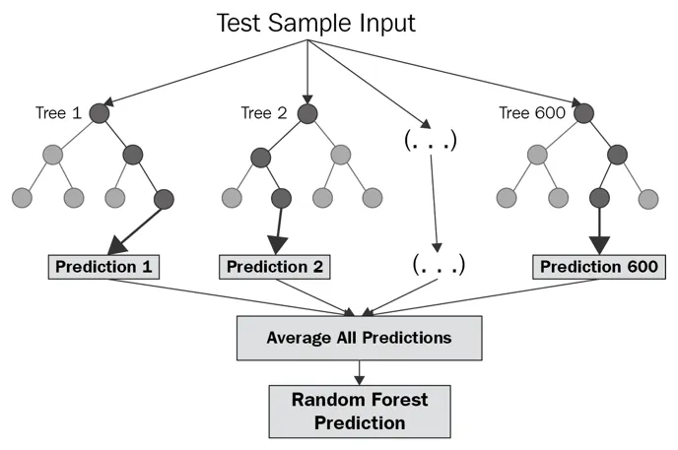
Random Forest :
To achieve more accurate and consistent prediction, random forest creates several decision trees and combines them together. The major benefit of using it is its ability to solve both regression and classification issues. When building each individual tree, it employs bagging and feature randomness in order to produce an uncorrelated tree forest whose collective forecast has much better accuracy than any individual tree’s prediction. In this algorithm, during the splitting of nodes it takes only random subset of nodes into an account. When splitting a node, it looks for the best feature from a random group of features rather than the most significant feature. This results into getting better accuracy. It efficiently deals with the huge datasets. It also solves the issue of overfitting in datasets. It works as follows: First, it’ll select random samples from the provided dataset. Next, for every selected sample it’ll create a decision tree and it’ll receive a forecasted result from every created decision tree. Then for each result which was predicted, it’ll perform voting and through voting it will select the best predicted result.

Slide 14
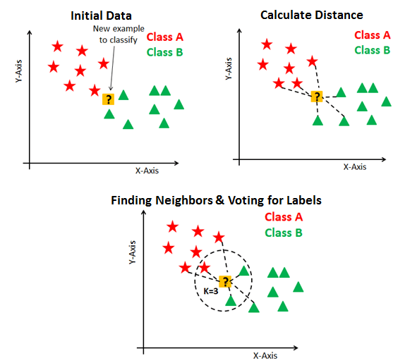
K Nearest Neighbor (KNN) :
KNN assumes similar objects are nearer to one another. When the parameters are continuous in that case knn is preferred. In this algorithm it classifies objects by predicting their nearest neighbor. It’s simple and easy to implement and also has high speed because of which it is preferred over the other algorithms when it comes to solving classification problems. The algorithm classifies whether or not the patient has affected by brain stroke dataset as an input.
Algorithm takes following steps :-
Step 1: Select the value for K.
Step 2 : Find the Euclidean distance of K no. of neighbors.
Step 3 : Based on calculated distance, select the K nearest neighbors in the training 13 data which are nearest to unknown data points.
Step 4 : Calculate no. of data points in each category among these K neighbors.
Step 5 : Assign new data points to the category which has the maximum no. of neighbors.
Step 6 : Stop.

Slide 15
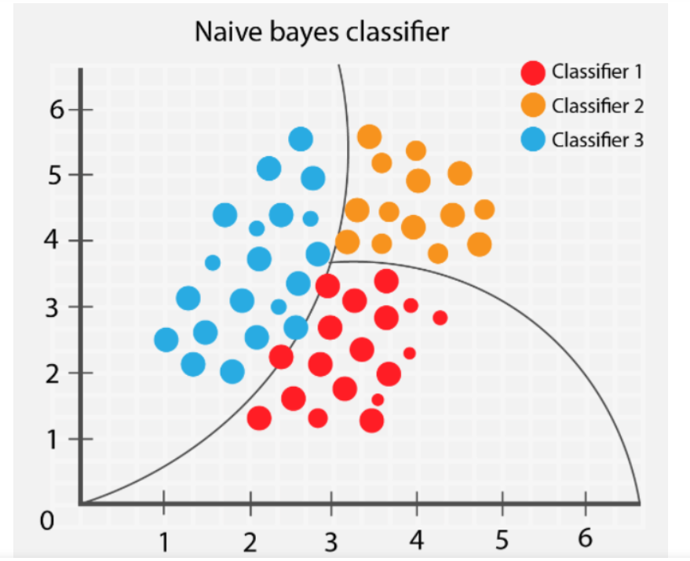
Naive Bayes :
Naive Bayes is a probabilistic machine learning algorithm which is mainly used in classification problems. It’s based on Bayes theorem. It is simple and easy to build. It deals with huge datasets efficiently. It can solve complicated classification problems. The existence of a specific feature in a class is assumed to be independent of the presence of any other feature according to naïve bayes theorem.
It’s formula is as follows :
P(S|T) = P(T|S) * P(S) / P(T)
Here, T is the event to be predicted,
S is the class value for an event.
This equation. will find out the class in which the expected feature for classification.

Slide 16

Support Vector Machine (SVM) :
The primary role of SVM algorithm is that it separates two classes by creating a line of hyperplanes. Data points which are closest to the hyperplane or points of the data set that, if deleted, would change the position of dividing the hyperplane are known as support vectors. As a result, they might be regarded as essential components of the data set. The margin is the distance between hyperplane and nearest data point from either collection. The goal is to select the hyperplane with the maximum possible margin between it and any point in the training set increasing the likelihood of a new data being properly classified. SVM’s main objective is to find a hyperplane in N-dimensional space which will classify all the data points. The dimension of a hyperplane is actually dependent on the quantity of input features. If input has two features in that case the hyperplane will be a line and two dimensional plane.

Slide 17
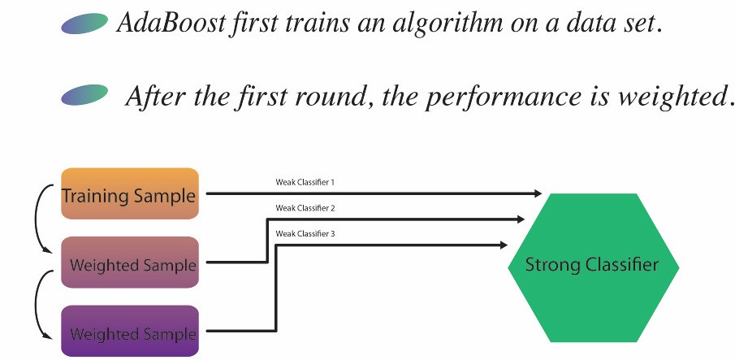
AdaBoost Classifier :
AdaBoost combines multiple classifiers to increase the accuracy of classifiers. AdaBoost is an iterative ensemble method. AdaBoost classifier builds a strong classifier by combining multiple poorly performing classifiers so that you will get high accuracy strong classifier. The basic concept behind Adaboost is to set the weights of classifiers and training the data sample in each iteration such that it ensures the accurate predictions of unusual observations. Any machine learning algorithm can be used as base classifier if it accepts weights on the training set. Adaboost should meet two conditions:
The classifier should be trained interactively on various weighed training examples.
In each iteration, it tries to provide an excellent fit for these examples by minimizing training error.

Slide 18
Implementation Steps :
As we already discussed in the methodology section about some of the implementation details. So, the language used in this project is Python programming. We’re running python code in anaconda navigator’s Jupyter notebook. Jupyter notebook is much faster than Python IDE tools like PyCharm or Visual studio for implementing ML algorithms. The advantage of Jupyter notebook is that while writing code, it’s really helpful for Data visualization and plotting some graphs like histogram and heatmap of correlated matrices.
Let’s revise implementation steps :
Dataset collection.
Importing Libraries : Numpy, Pandas, Scikit-learn, Matplotlib and Seaborn libraries were used.
Exploratory data analysis : For getting more insights about data.
Data cleaning and preprocessing : Checked for null and junk values using isnull() and isna().sum() functions of python. In Preprocessing phase, we did feature engineering on our dataset. As we converted categorical variables into numerical variables using function of Pandas library. Both our datasets contains some categorical variables.
Feature Scaling : In this step, we normalize our data by applying Standardization by using StandardScalar() and fit_transform() functions of scikit-learn library.

Slide 19
Model selection : We first separated x’s from y’s. x’s are features or input variables of our datasets and y’s are dependent or target variables, which are crucial for predicting disease. Then using by the importing model_selection function of the sklearn library, we splitted our x’s and y’s into train and test split using train_test_split() function of sklearn. We splitted 75% of our data for training and 25% for testing.
Applied ML models and created a confusion matrix of all models.
Deployment of the model which gave the best accuracy.

Slide 20
Libraries:
import numpy as np
import pandas as pd
import matplotlib.pyplot as plt
import seaborn as sns
import plotly.express as px
from plotly.subplots import make_subplots
import warnings
warnings.filterwarnings('ignore’)
from sklearn.model_selection import train_test_split
from sklearn.metrics import confusion_matrix
from sklearn.metrics import classification_report
from sklearn.preprocessing import StandardScaler
from sklearn.metrics import accuracy_score
from sklearn.tree import DecisionTreeClassifier
from sklearn.ensemble import RandomForestClassifier
from sklearn.neighbors import KNeighborsClassifier
from sklearn.naive_bayes import GaussianNB
from sklearn.svm import SVC

Slide 21
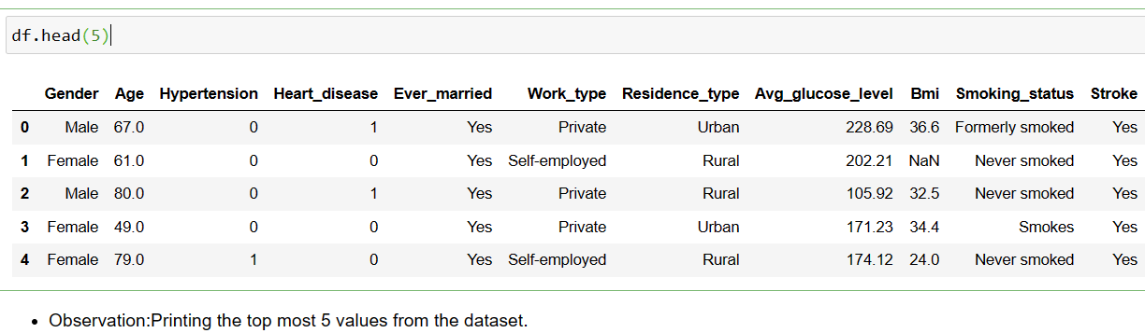
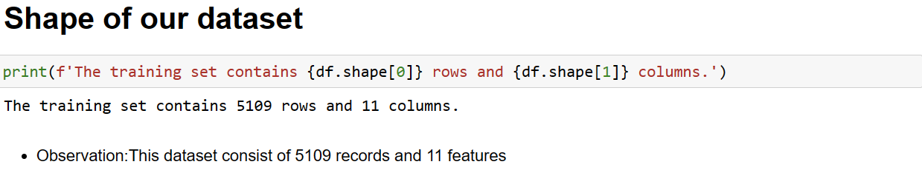
Data Wrangling

Slide 22
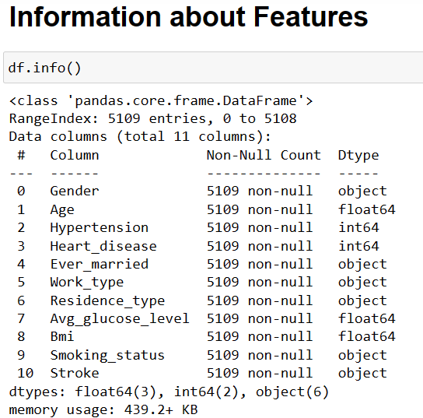

Slide 23
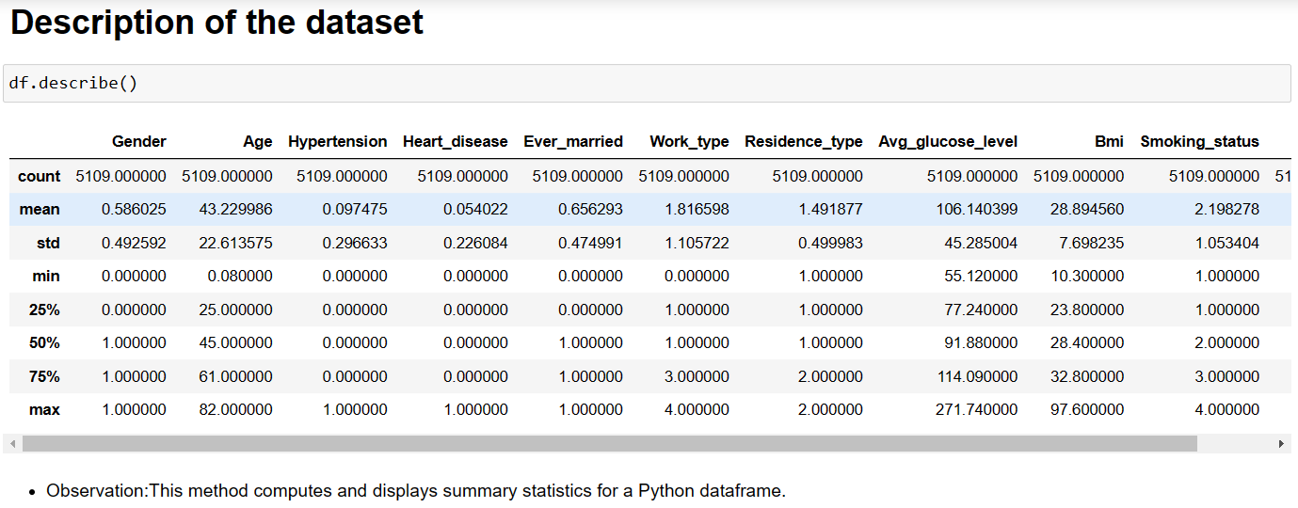

Slide 24
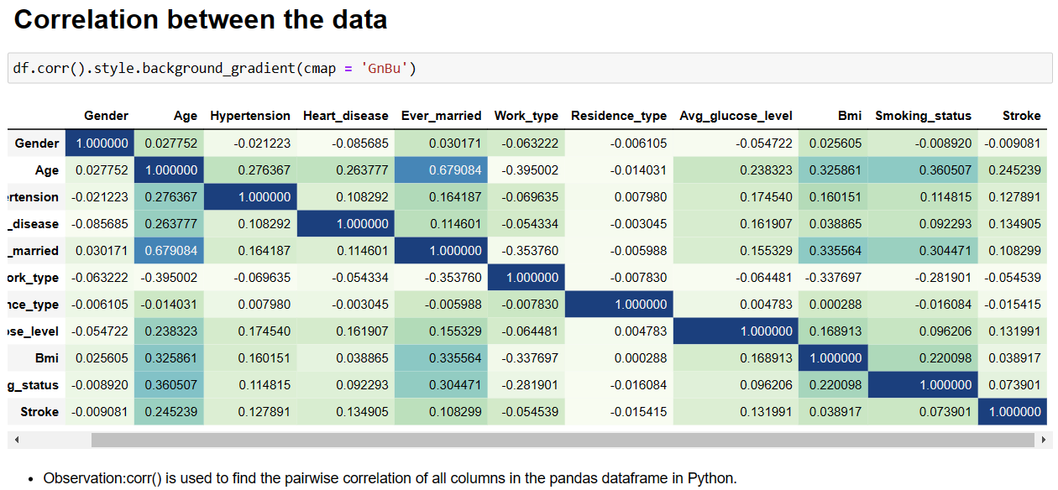
Exploratory Data Analysis :
Correlation Matrix- let's you see correlations between all variables. Within seconds, you can see whether something is positively or negatively correlated with our predictor (target).

Slide 25

We can see there is a positive correlation between Hypertension & Stroke. This makes sense since, The greater amount of hypertension results in a greater chance of having brain stroke. Hypertension, is a ordinal feature with 2 values: Value 1: Yes , Value 2:No.
In addition, we see a negative correlation between exercise induced Work_type & Stroke. This makes sense because when you get more tension in work it increases the possibility stress which leads to stroke.
Pair plot :
Pair plots can be useful for exploring the relationships between variables in a dataset and identifying patterns or outliers.
It is allows you to visualize the relationship between multiple variables in a dataset.

Slide 26
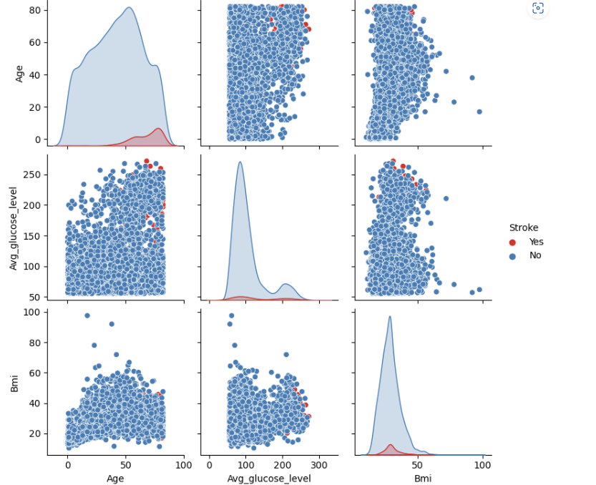
Here we can see the pair plot for Age, Avg_glucose_level, Bmi for the stroke value. It with only continuous columns from our data, because with so many features, it can be difficult to see each one. Through this we can see the presence of any ouliers.

Slide 27
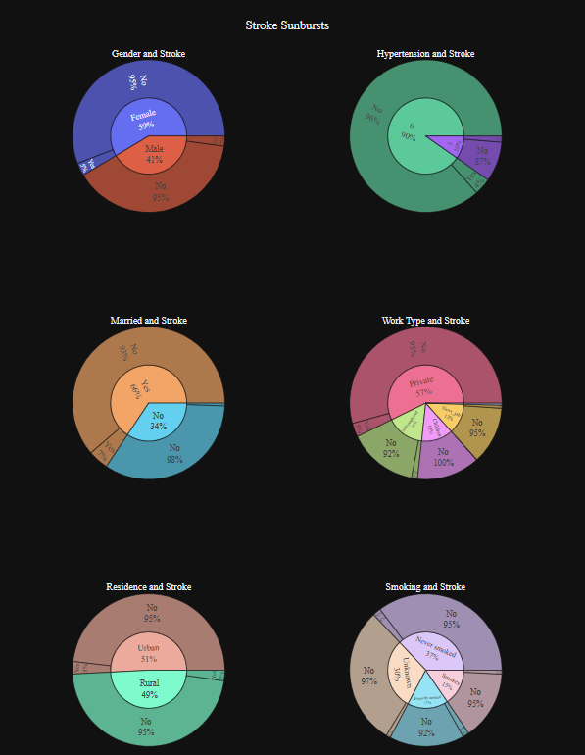
Sunburst :
The chart shows the proportion of individuals who had a stroke and those who did not have a stroke within different subgroups of each categorical variable.
The subgroups are represented by different levels of the hierarchy, with the outermost ring representing the categorical variable and each inner ring representing a subgroup of that variable.

Slide 28
Machine learning and Predictive Analytics:
Prepare the data :
To prepare data for modeling, just remember ASN (Assign, Split, Normalize).
Assign: The 10 features to x, & the last column to our classification predictor,y.
x = df.drop(['Stroke'],axis = 1).values
y = df['Stroke'].values
Split: The data set into the Training set and Test set,
from sklearn.model_selection import train_test_split x_train,x_test,y_train,y_test=train_test_split(x,y,test_size=0.25)
Normalize: Standardizing the data will transform the data so that its distribution will have a
mean is 0 and a variance is 1.
from sklearn.preprocessing import StandardScaler
sc = StandardScaler()
x_train = sc.fit_transform(x_train)
x_test = sc.transform(x_test)

Slide 29
Modeling /Training :
We will now Train various Classification Models on the Training set & see which yields the highest accuracy. We will compare the accuracy of
Decision Trees,
Random Forest,
KNN,
Naives Bayes Classifier,
SVM,
AdaBoost Classifier.
Note: These are all supervised learning models.

Slide 30
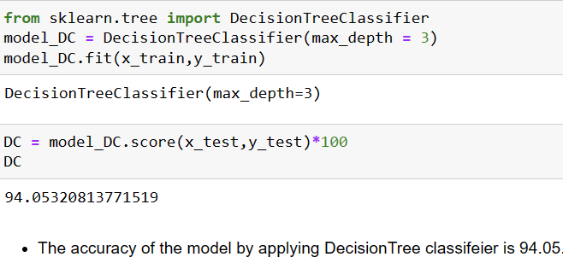
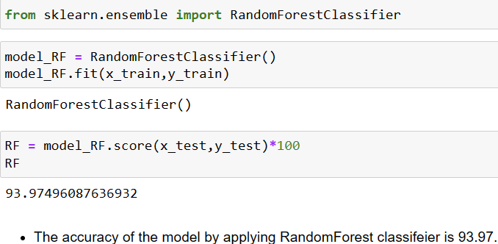
Model 1: Decision Trees
Model 2: Random Forest

Slide 31
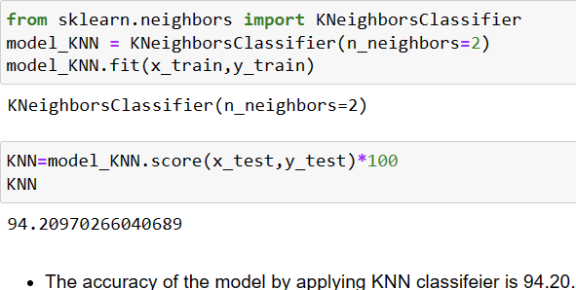
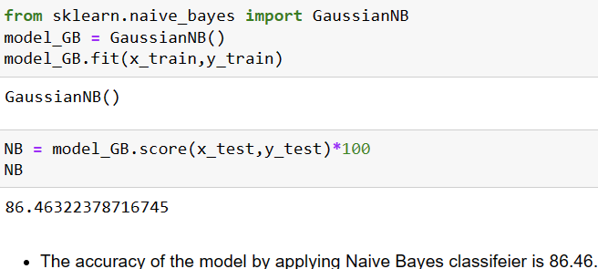
Model 3: K-NN (K-Nearest Neighbors)
Model 4: Naive Bayes Classifier

Slide 32
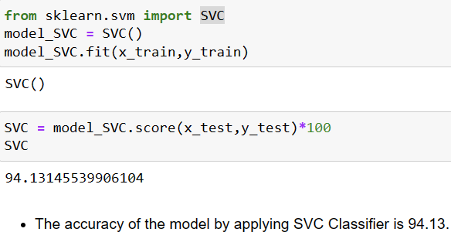
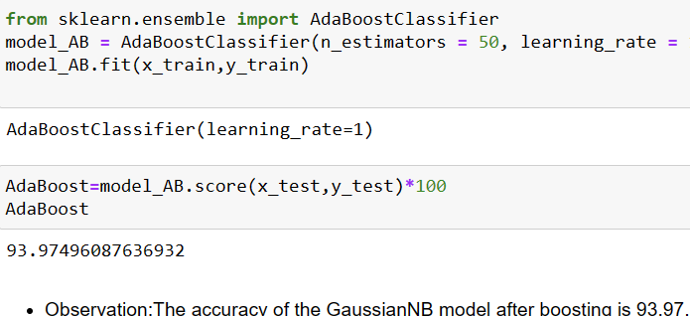
Model 5: SVM (Support Vector Machine)
Model 6: AdaBoosting

Slide 33
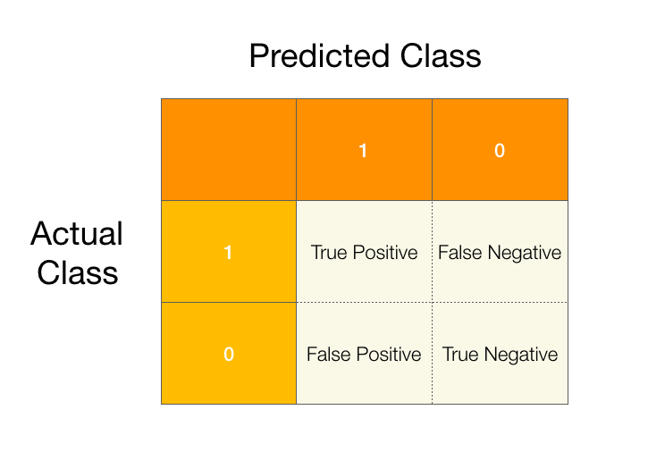
Measuring Model Performance :
While there are other ways of measuring model performance (precision, recall, F1 Score, ROC Curve, etc), let's keep this simple and use accuracy as our metric. To do this are going to see how the model performs on new data (test set).
Accuracy is defined as: (fraction of correct predictions): correct predictions / total number of data points .

Slide 34
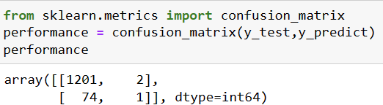
1201 is the amount of True Positives in our data, while 1 is the amount of True Negatives.
2 & 74 are the number of errors.
There are 74 type 1 error (False Positives)- You predicted positive and it’s false.
There are 2 type 2 error (False Negatives)- You predicted negative and it’s false.
Hence if we calculate the accuracy its # Correct Predicted/ # Total. In other words, where TP, FN, FP and TN represent the number of true positives, false negatives, false positives and true negatives.
(TP + TN)/(TP + TN + FP + FN). (1201+1)/(1201+2+74+1) = 0.94= 94% accuracy.
Note: A good rule of thumb is that any accuracy above 80% is considered good, but be careful because if your accuracy is extremly high, it may be too good to be true (an example of Overfitting). Thus, 94% is the ideal accuracy!.

Slide 35
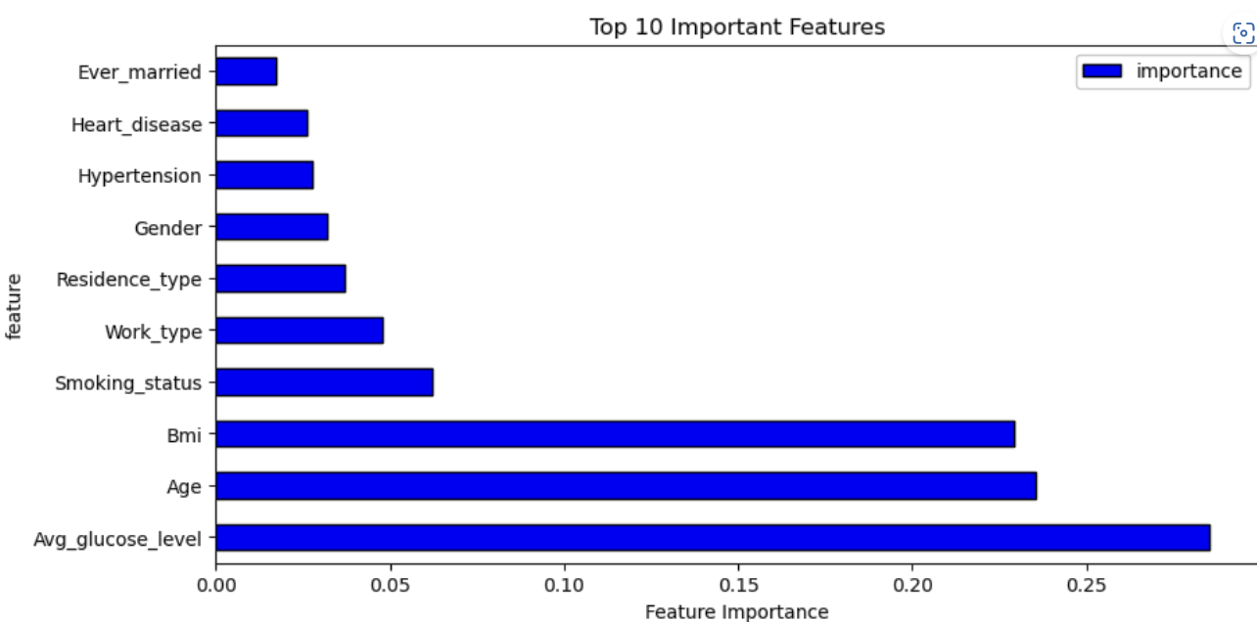
Feature Importance :
Feature Importance provides a score that indicates how helpful each feature was in our model.
The higher the Feature Score, the more that feature is used to make key decisions & thus the more important it is.
From the Feature Importance graph a, we can conclude that the top 3 significant features were maximum stroke achieved by Avg_glucose_level, Age and Bmi.

Slide 36
Precautions :
Managing blood sugar levels: Keeping glucose levels in a healthy range is important to reduce the risk of stroke. This can be done by following a healthy diet, exercising regularly, and monitoring blood sugar levels regularly.
Maintaining a healthy weight: A high body mass index (BMI) is a risk factor for stroke, so maintaining a healthy weight through diet and exercise is important.
Controlling high blood pressure: High blood pressure is a leading cause of stroke, so it is important to monitor and control it through lifestyle changes and medication if necessary.
Exercising regularly: Regular exercise can help control blood sugar levels, maintain a healthy weight, and reduce stress, all of which can reduce the risk of stroke.
Quitting smoking: Smoking is a major risk factor for stroke, so quitting smoking is important to reduce the risk.
Managing stress: Chronic stress can increase the risk of stroke, so it is important to manage stress through relaxation techniques, exercise, and other stress management methods.
Eating a healthy diet: A diet rich in fruits, vegetables, whole grains, and lean protein can help control blood sugar levels and reduce the risk of stroke.

Slide 37
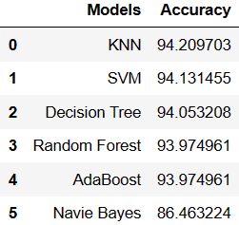
Chapter – 4 Analysis of the Result
We used precision, F1-score, recall and accuracy evaluation metrics for evaluating our models. False Positive(FP) is when a model incorrectly predicts a positive outcome. False Negative(FN) is when a model incorrectly predicts the negative outcome. True Positive(TP) is when model correctly predicts a positive outcome. True Negative(TN) is when a model correctly predicts a negative outcome. Page Precision=TP/(TP+FP) Recall = TP / (TP + FN).

Slide 38

Predictions :
Scenario: A patient develops brain stroke symptoms & your input is vitals into the Machine Learning Algorithm.
She is a 58 year old female, with a glucose level of 144.16 with a bmi of 26.
In addition she has smokes (3).
She was a married (1) women works in private sector (1) from a rural area (2).
She is not affected by hypertension (0) but affected by heart disease (1).
Yes! Our machine learning algorithm has classified this patient with no Brain Stroke.

Slide 39
Chapter – 5 Conclusions
KNN algorithm yields the highest accuracy, 94.2%. Any accuracy above 80% is considered good, but be careful because if your accuracy is extremely high, it may be too good to be true (an example of Overfitting). Thus, 94.2% is the ideal accuracy!
Out of the 10 features we examined, the top 3 significant features that helped us classify between a positive & negative maximum stroke achieved by Avg_glucose _level, Age and Bmi .
Our machine learning algorithm can now classify patients with Brain Stroke. Now we can properly thrombectomy, & get them the help they needs to recover. By detecting these features early, we may prevent worse symptoms from arising later.

Slide 40
References:
Ntaios G, Faouzi M, Ferrari J, Lang W, Vemmos K, Michel P. An integer-based score to predict functional outcome in acute ischemic stroke: the ASTRAL score.Neurology. 2012; 78:1916–1922. doi: 10.1212/WNL.0b013e318259e221.
van Os HJA, Ramos LA, Hilbert A, van Leeuwen M, van Walderveen MAA, Kruyt ND, et al. Predicting outcome of endovascular treatment for acute ischemic stroke: potential value of machine learning algorithms.Front Neurol. 2018; 9:784.
Cuadrado-Godia E, Dwivedi P, Sharma S, Ois Santiago A, Roquer Gonzalez J, Balcells M, et al. Cerebral small vessel disease: a review focusing on pathophysiology, biomarkers, and machine learning strategies.J Stroke. 2018; 20:302–320. doi: 10.5853/jos.2017.02922.

